Slide 1
Meeting Outline
Asked for extension of 4 weeks
  Got accepted new deadline 25 Oktober
Closed-loop training
  Main issue was not a big enough error between system and baseline for the additional states
    Additional states learning
GPU implementation
  Earlier attempt no speedup
Longer training runs
  More complex neural network and more additional states → no real benefit
L-BFGS
Transient issue

Slide 2
System Error not big enough?
MSD payload mass previously: 10% and 90% respectively
For the following images 50%-50% split, and the excitation amplitude scaled 5x, taking the input force from 4.4e+01 N to 2.2e+02 N RMS on X1/X2 and 3.6e+01 N to 1.4e+02 N on Y.
Notes:
Force ratio is not 5x across the dataset. It ranges 0.98x to 5.07x.- Standstills and Y-sweeps: ~5.0x on X, ~3.75x on Y (T1-T7, V1, V3, E2)- APRBS and lissajous: 1.2x to 2.9x- E4_multisine_off: 1.00x, unchangedBecause AMP_SCALE scales the excitation, not the total input. On a standstill the force is almost pure excitation so it scales ~5x; on an APRBS record the trajectory-following force dominates and barely moves.
Net effect on the absorber displacement, which is what the augmentation has to learn: 2.19e-05 m to 3.17e-05 m, a factor 1.45, because the mass-fraction change worked against the amplitude change.

Slide 3
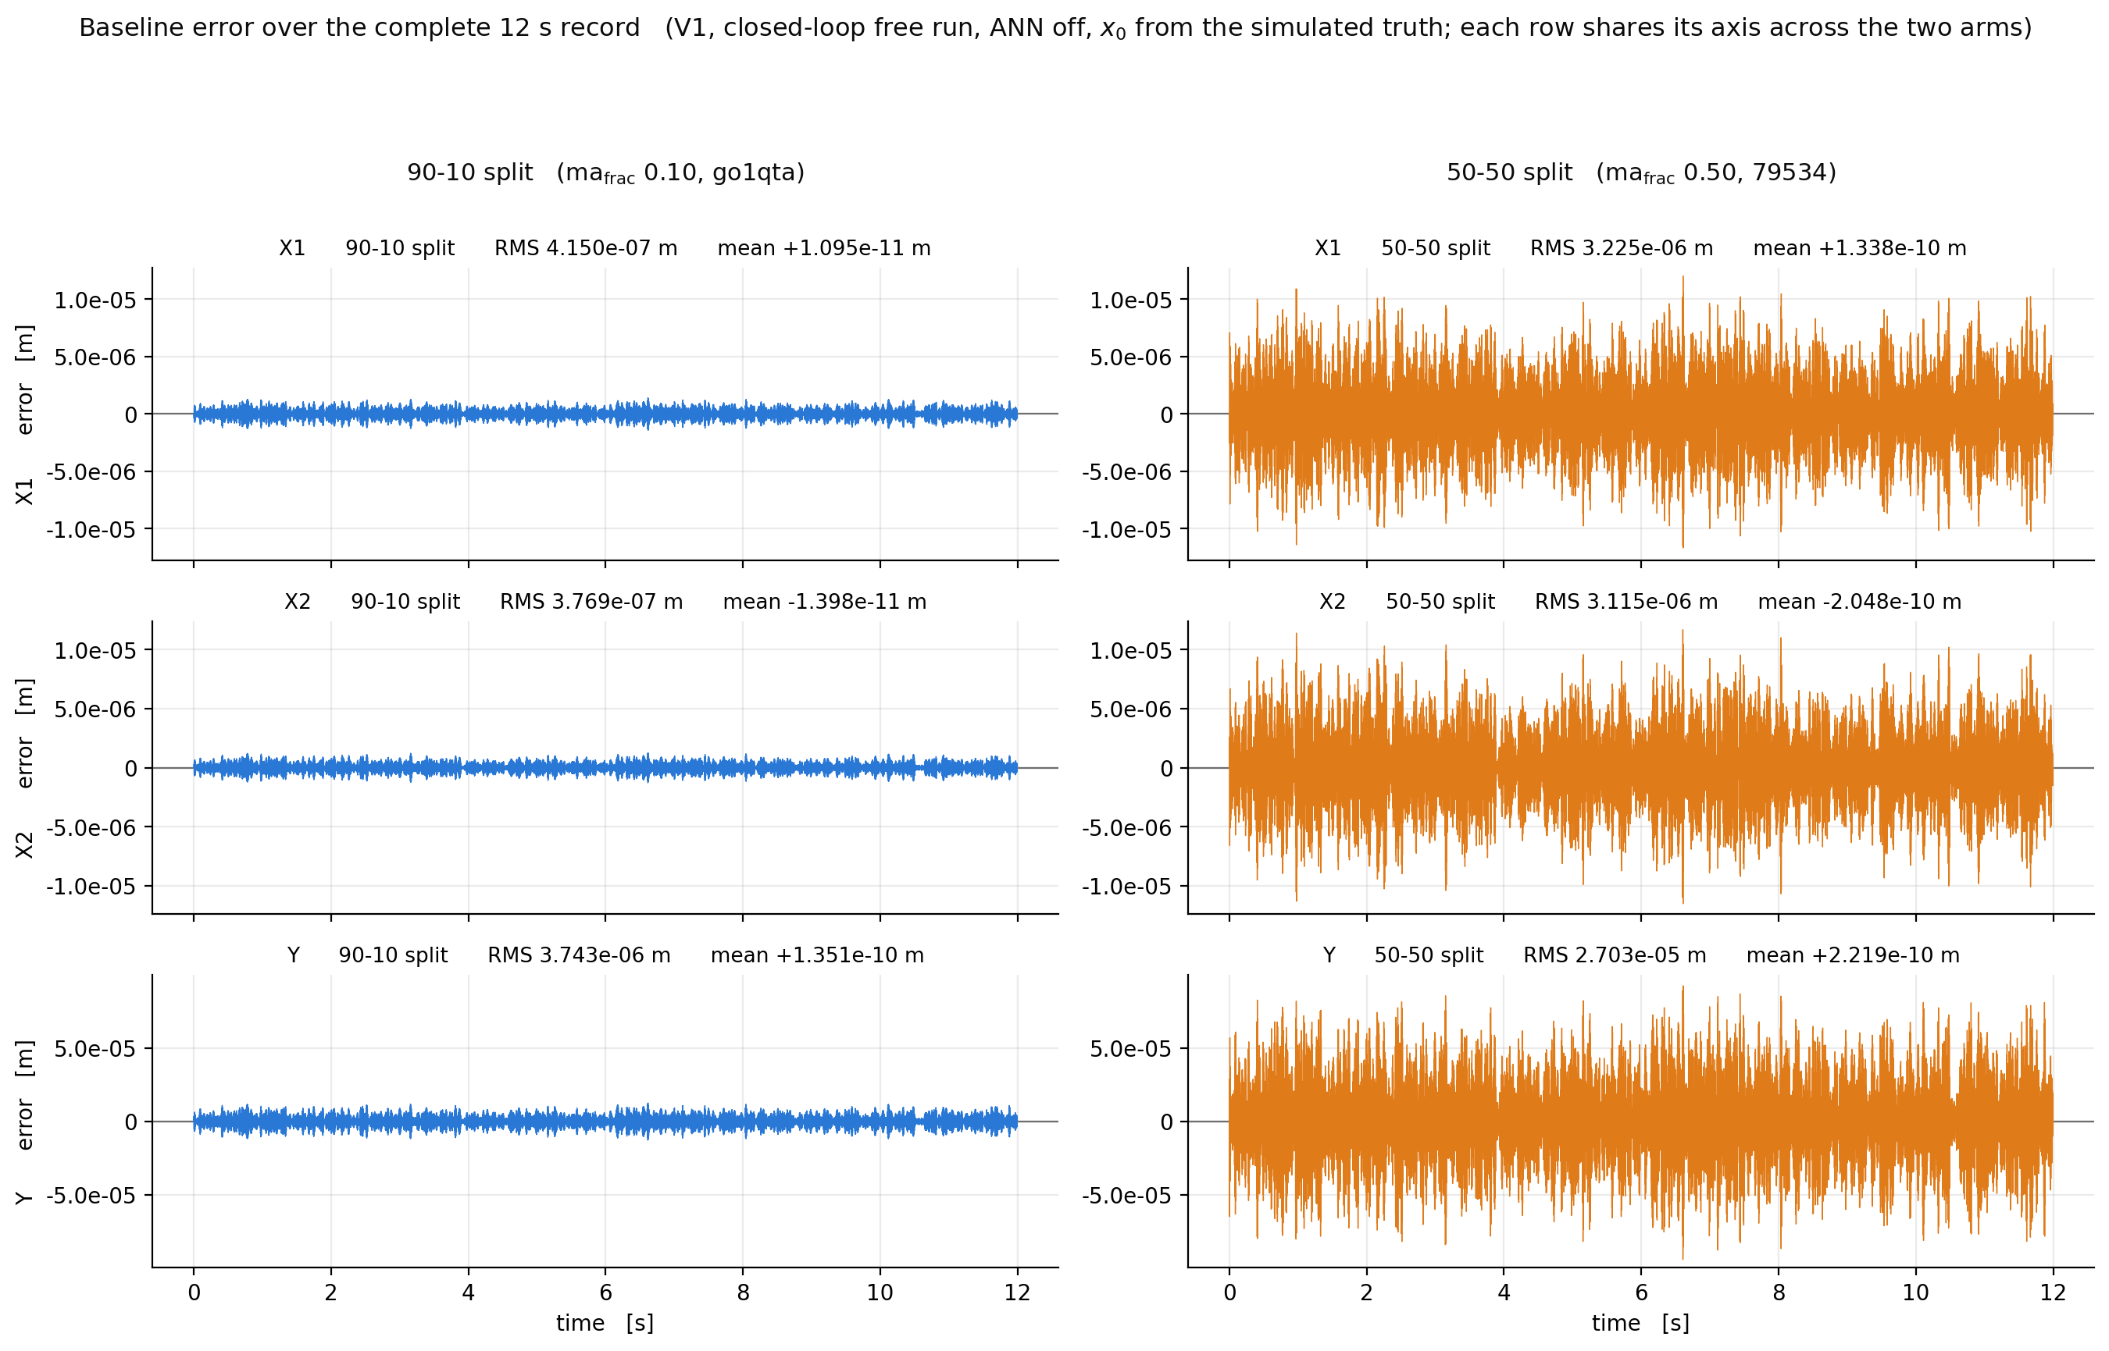

Slide 4
New setup – Dynamics moved
With the 50-50 split the resonance moved
New multisine band now spans:
  140 to 230 Hz

Slide 5
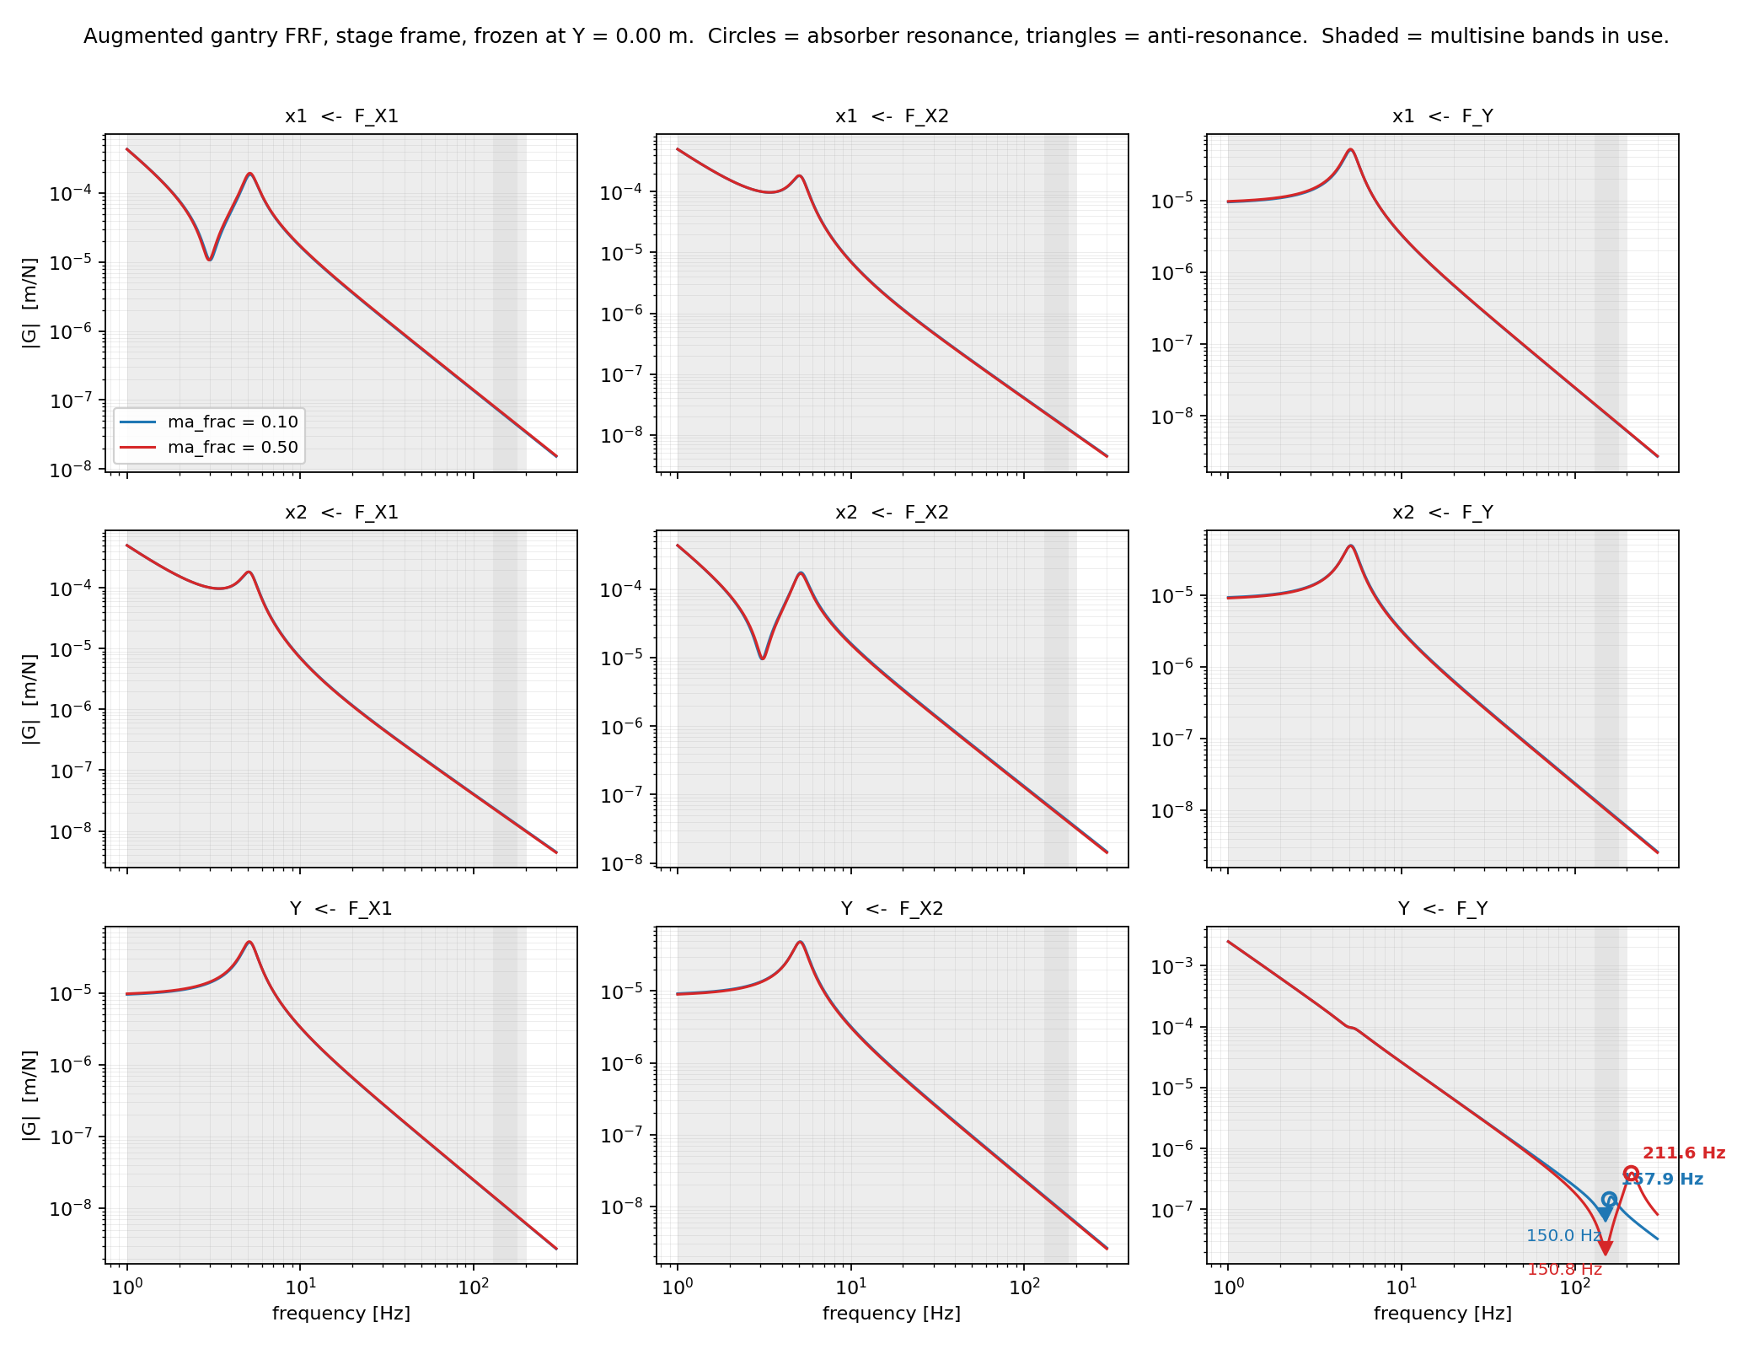

Slide 6
GPU training
Why the GPU did not help before
  The model does thousands of tiny operations, almost no real computation
  Cost is dominated by sending work to the GPU, not by doing it
  A stronger GPU changes nothing: two cards with 4.5x different power gave the same speed
What changed
  Compiling the model merges those tiny operations and replays them as one block
  This was blocked by a single line in the framework; fixing it left the model unchanged
  Once cost is per operation, a larger batch is nearly free
Result
  ~10x faster per update, ~20x more data per second
  18 epochs → ~350 epochs in the same wall time
Takeaway
  The GPU was not computing too slowly, it was being fed too slowly
Notes:
In model_augmentation/fit_systems/interconnect.py, inside init_forward, at line 212:# beforeself.order_output_signal_computation.append(element)# afterself.order_output_signal_computation.append(int(element))

Slide 7
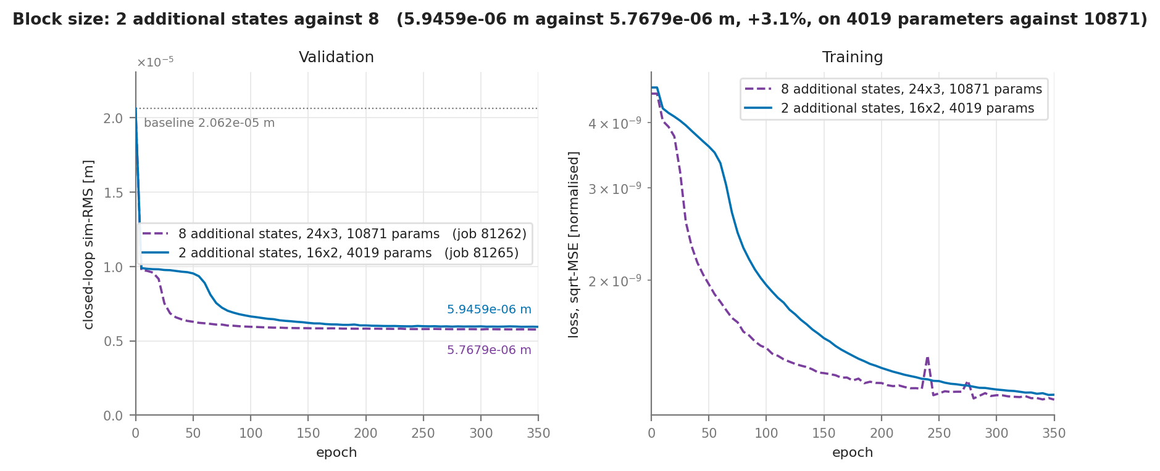
Capturing missing dynamics
2 vs 8 additional states

Slide 8
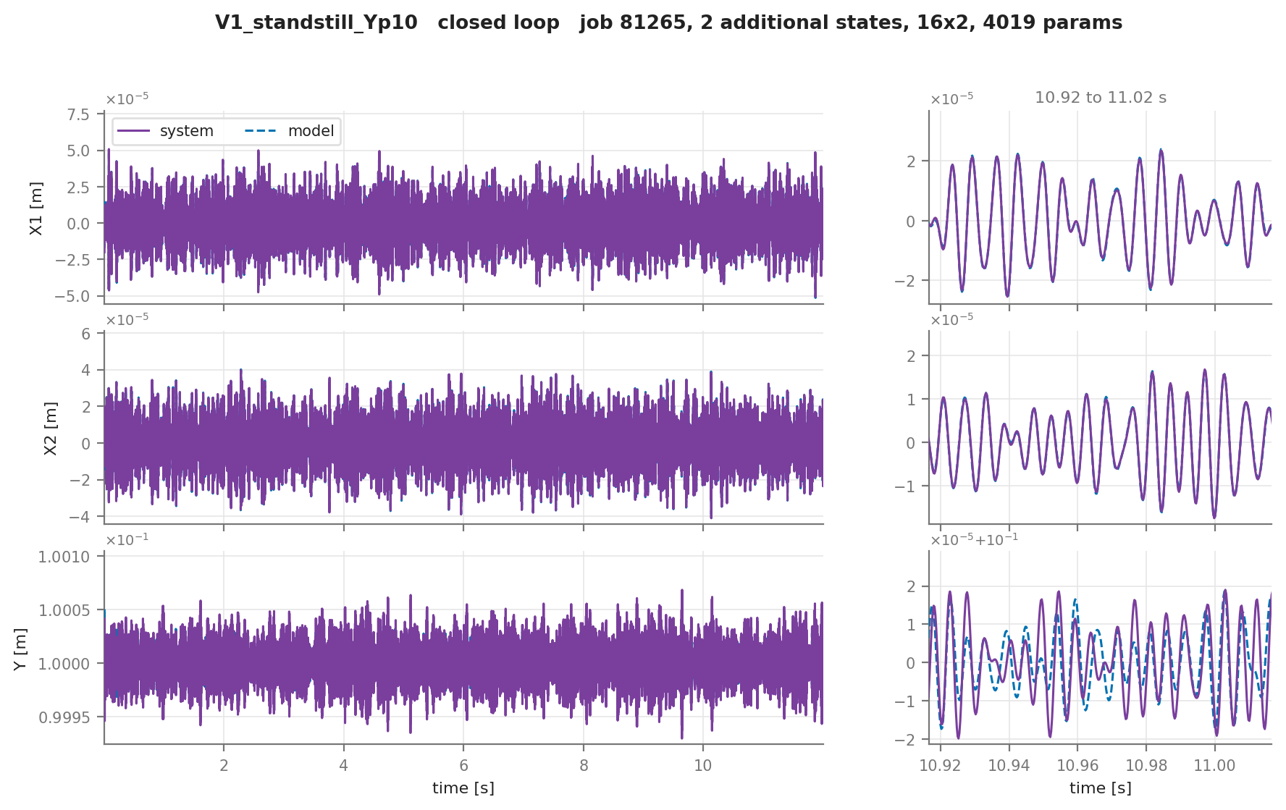

Slide 9
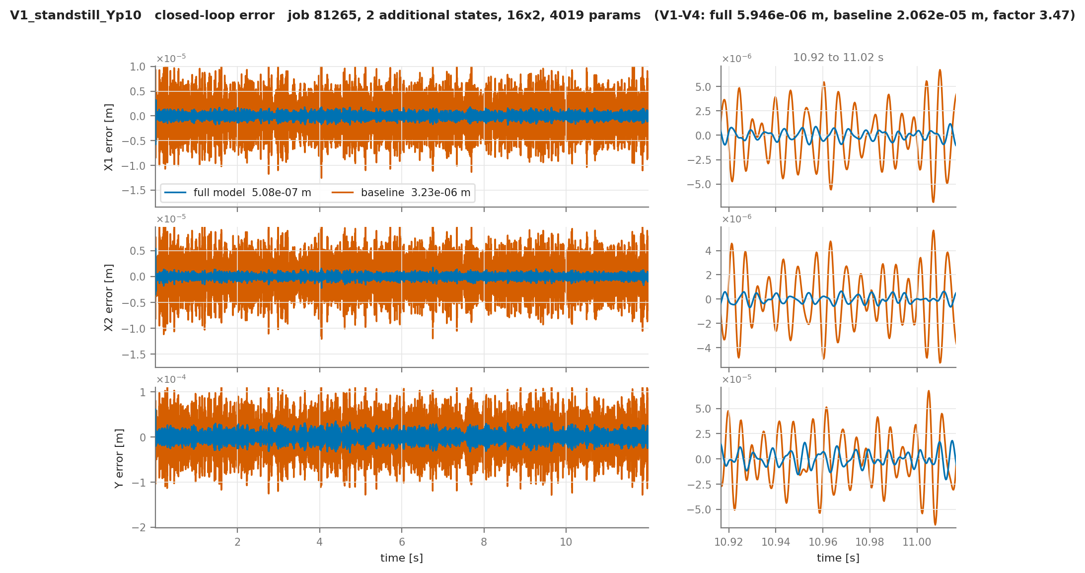

Slide 10
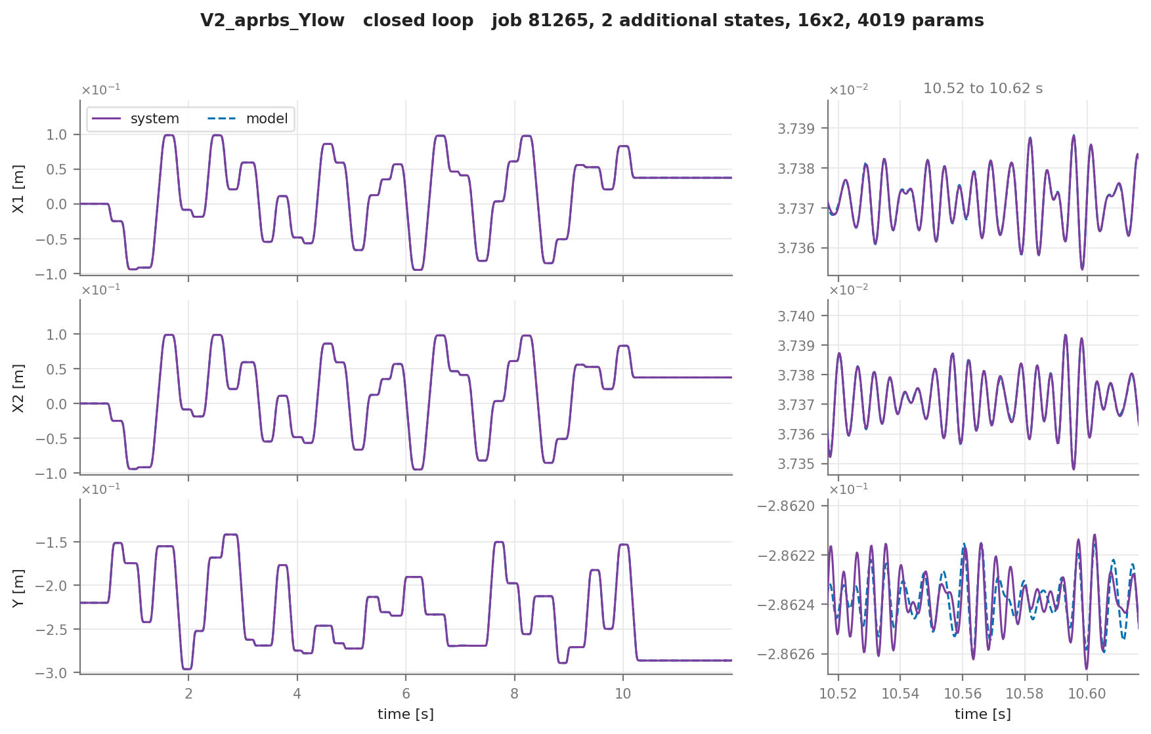

Slide 12
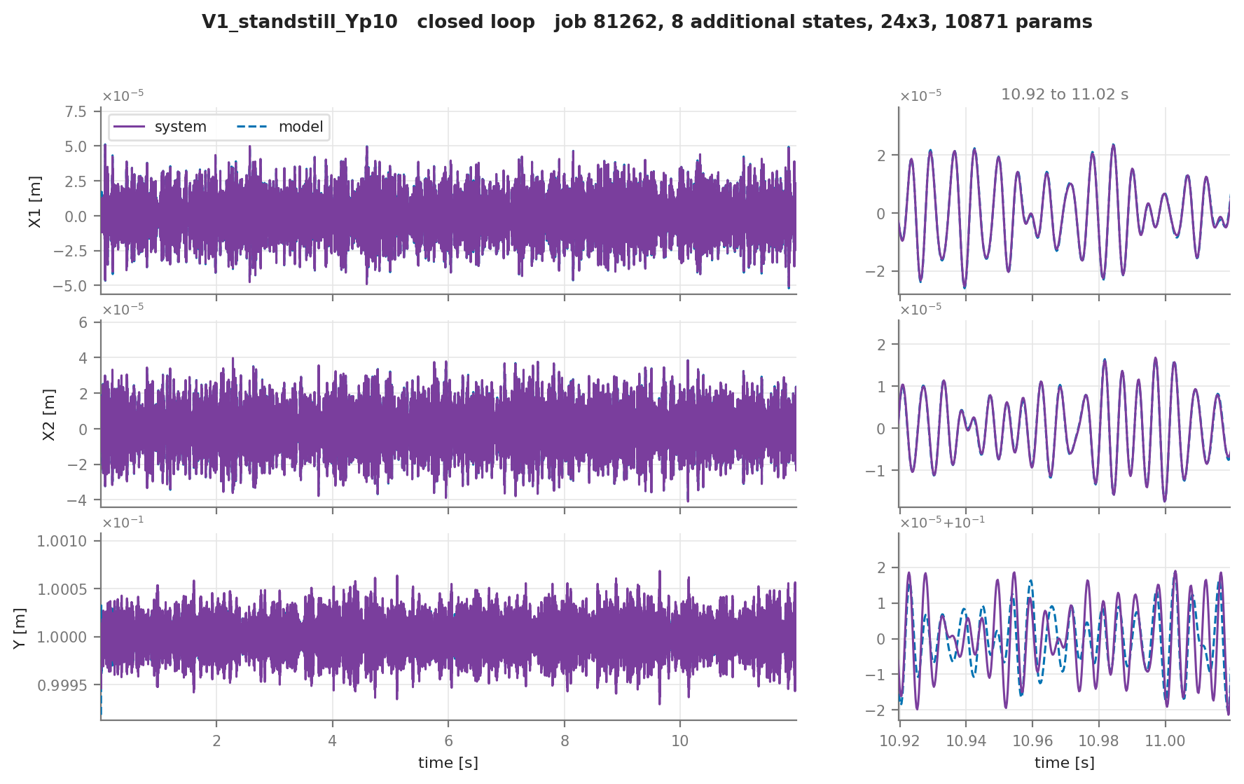

Slide 13


Slide 15
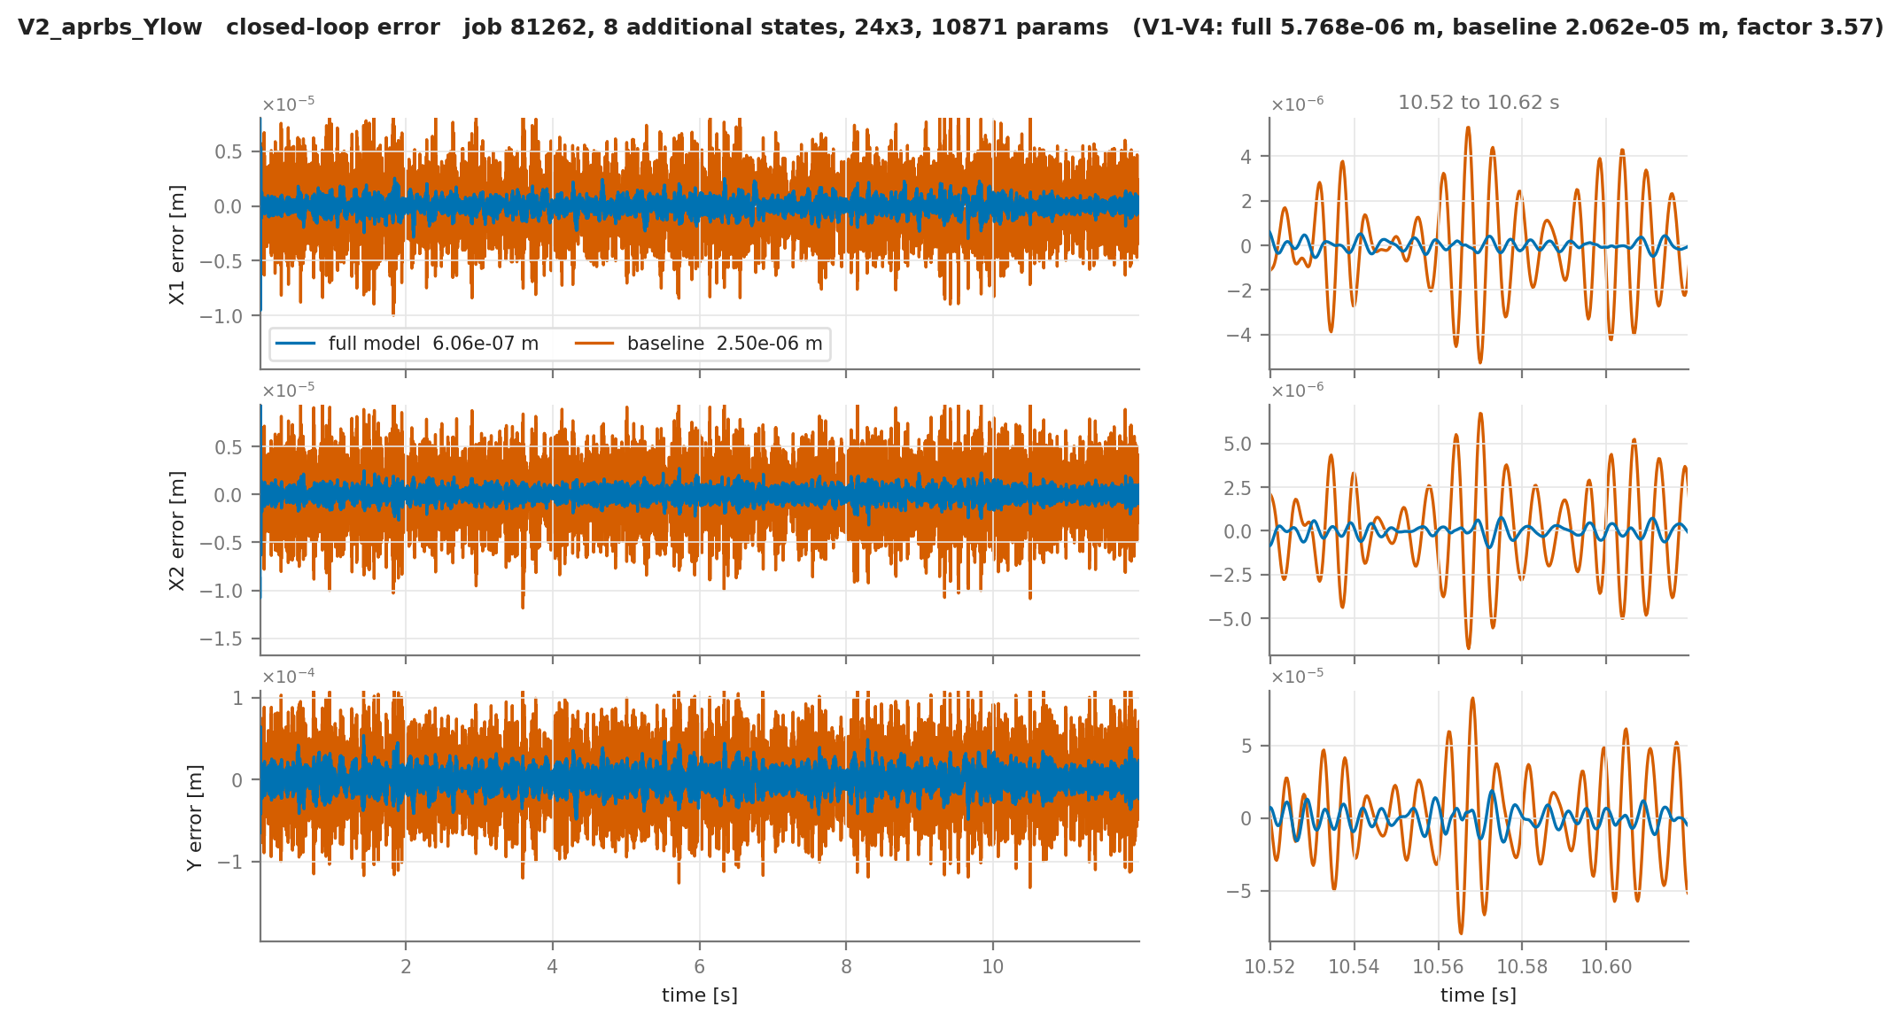

Slide 16
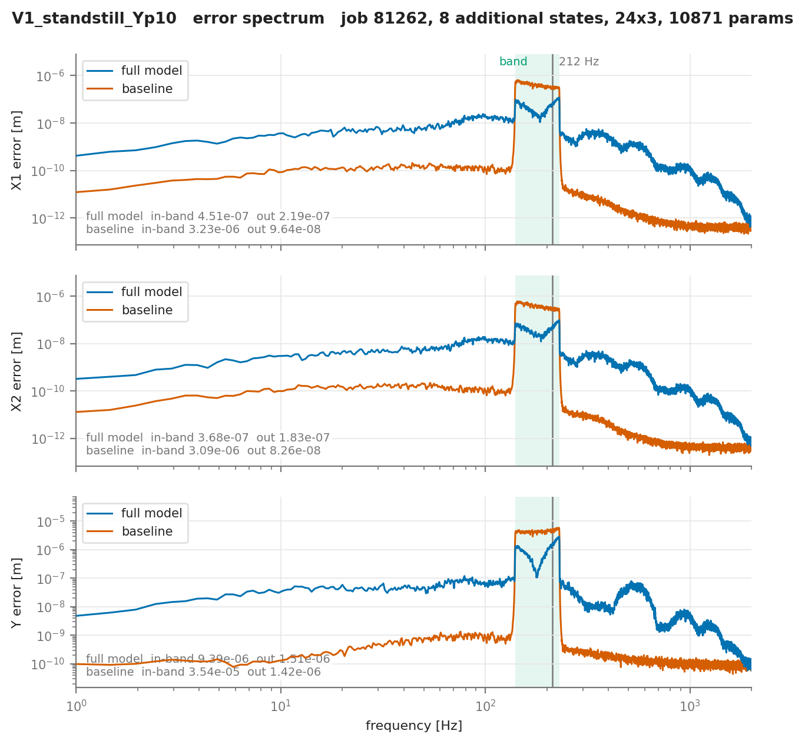
Model
Currently only multisine excitation around the resonance from the absorber excited

Slide 17
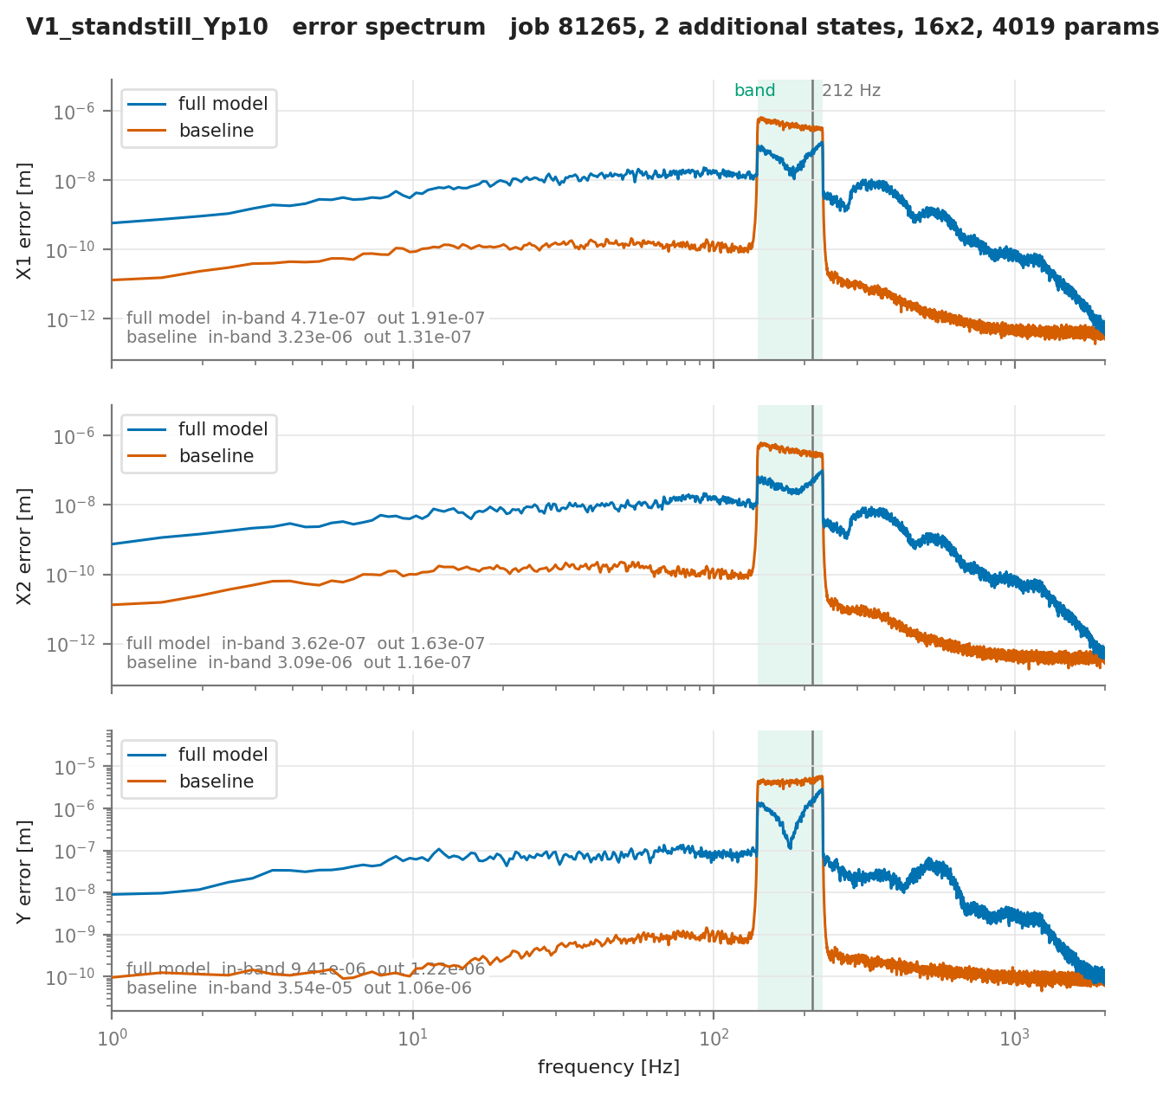

Slide 18
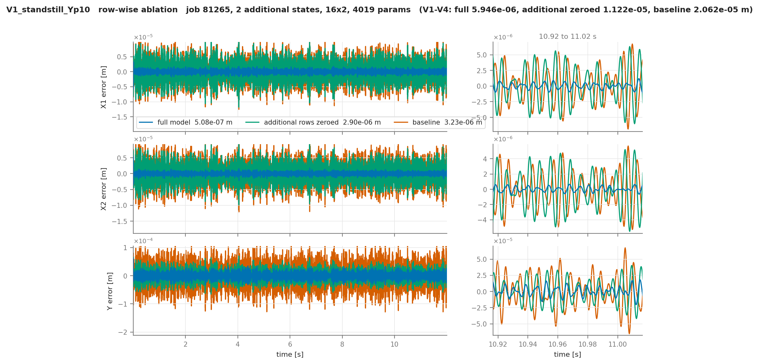
Additional states learning

Slide 20
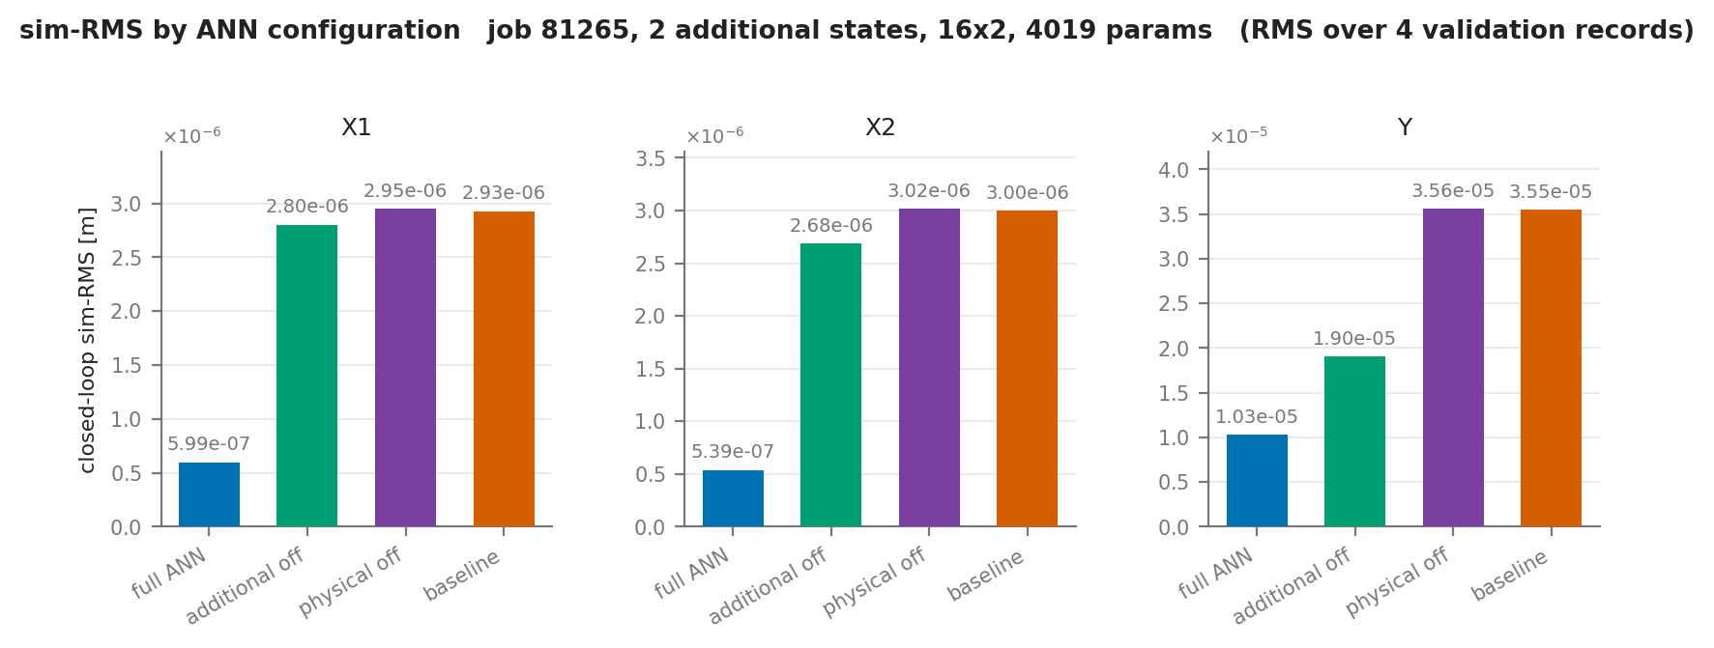

Slide 21
Quasi-newton
L-BFGS
Run after adam optimizer
L-BFGS is useful to get the last percentages
Adam takes small fixed-size steps and doesn't know the shape of the valley it's in
L-BFGS estimates that shape from the last x gradients, so it knows which way is downhill and how far to go
That's useless far from the optimum, and very effective near it
  Making it good at squeezing out the last few percentages
Notes:
After Adam, not instead of it: Adam explores, the quasi-Newton phase converges.
- One fixed batch of 16384 windows, held constant for the whole phase, because a fresh minibatch each iteration would break both the curvature estimate and the line search.
- All parameters in one vector, m = 50 stored pairs, strong-Wolfe line search.
- The result is kept only if it improves the closed-loop validation; otherwise the weights are restored exactly.

Slide 22
Quasi-newton
LBFGS
Performs at:
After adam optimizer
Useful to get the last percentages
Freeze encoder
Volledige Float64 run dus ook in adam
Met en zonder encoder frozen
Notes:
After Adam, not instead of it: Adam explores, the quasi-Newton phase converges.
- One fixed batch of 16384 windows, held constant for the whole phase, because a fresh minibatch each iteration would break both the curvature estimate and the line search.
- All parameters in one vector, m = 50 stored pairs, strong-Wolfe line search.
- The result is kept only if it improves the closed-loop validation; otherwise the weights are restored exactly.

Slide 23
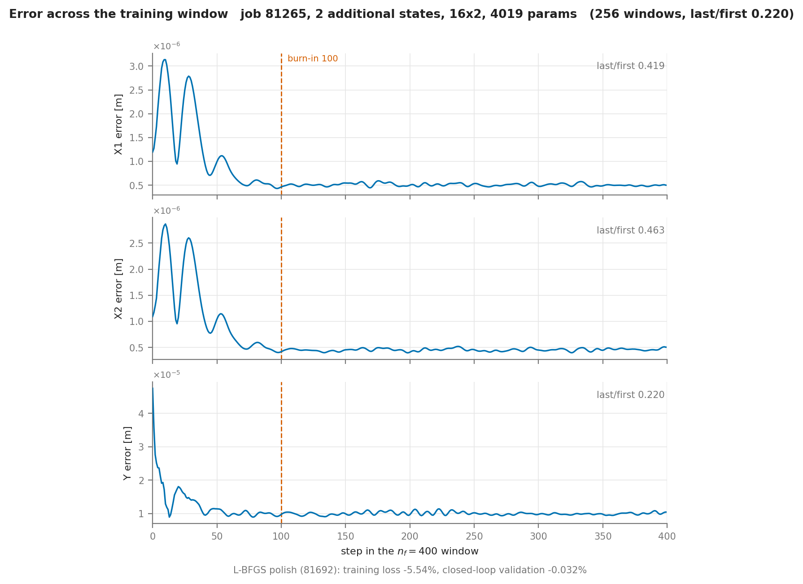
Transient error

Slide 25
Transient: Error is focused in the first samples
Encoder biased?
Does training prioritize the encoder initialization and due to the loss prevents us from learning the missing dynamics?
Mismatch between 12s validation and the 0.1s windows: validation only one encoder initialization over 12s
  → Initial state becomes less important
Proposed “burn in” → don’t include the first x amount of samples in the loss

Slide 26
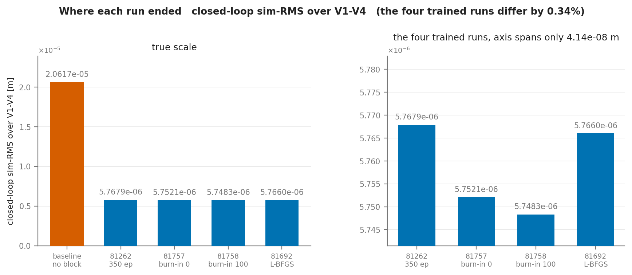
Notes:
│ step │ change │ share │
│ 81262 → 81757 (50 more epochs, no burn-in) │ −0.274% │ 81% │
│ 81757 → 81758 (burn-in 100 instead of 0) │ −0.066% │ 19% │
│ 81262 → 81758 (total) │ −0.339% │ 100% │

Slide 27
Orthogonality
Maybe just outline main objective / what are the gaps from gyorok to ours
Can I already say how I want to solve it??

Slide 28
Question
Not realistic simulation data
For if I don’t get to work on the real data due to time limit I should make the current setup more difficult besides noise.
Nonlinear → Add cubic spring
Would adding friction only in the simulation be a good idea?
The 50-50 mass split is not realistic perse, but I need a “big enough” error if I want the additional states to learn
  (Not the ANN correction to the existing physical states)

Slide 29
Planning

Slide 30
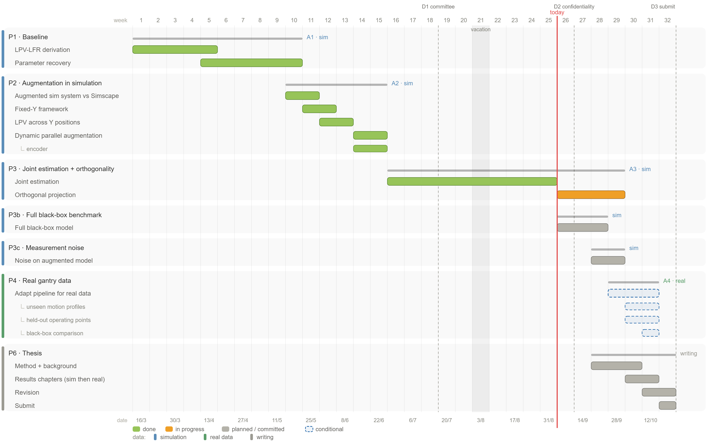

Slide 31
To do
Expand orthogonality for additional states
BLA + Full blackbox → comparison

Slide 33
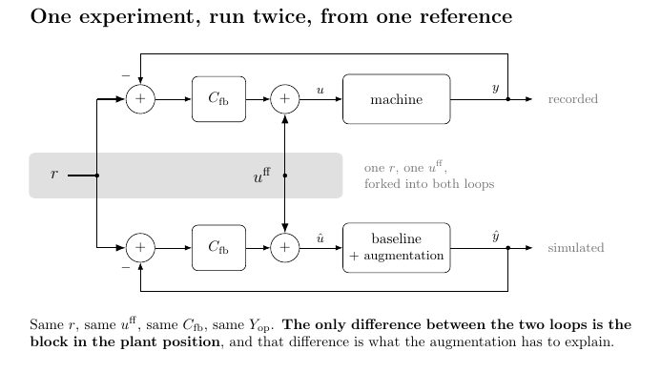
Notes:
Each simulation window we start with zero controller correction.
ŷ[k] = h(x[k]) <- model output at k, from the STATE only
e[k] = y[k] - ŷ[k]
u_fb[k]= Cc xc[k] + Dc e[k]
û[k] = u[k] + u_fb[k]x[k+1] = f(x[k], û[k]) <- û[k] produces ŷ[k+1], not ŷ[k]
xc[k+1]= Ac xc[k] + Bc e[k]
ŷ[k] is used to build û[k]; û[k] then moves the state forward and so determines ŷ[k+1]. It is not the same ŷ on both sides of the equal sign, it is k and k+1.
- Controller initial condition. xc = 0 at every window start.

Slide 34
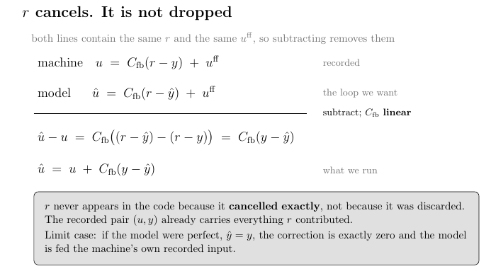
Notes:
Each simulation window we start with zero controller correction.
ŷ[k] = h(x[k]) <- model output at k, from the STATE only
e[k] = y[k] - ŷ[k]
u_fb[k]= Cc xc[k] + Dc e[k]
û[k] = u[k] + u_fb[k]x[k+1] = f(x[k], û[k]) <- û[k] produces ŷ[k+1], not ŷ[k]
xc[k+1]= Ac xc[k] + Bc e[k]
ŷ[k] is used to build û[k]; û[k] then moves the state forward and so determines ŷ[k+1]. It is not the same ŷ on both sides of the equal sign, it is k and k+1.
- Controller initial condition. xc = 0 at every window start.

Slide 35

Baseline model

Slide 36

System for data generation

Slide 37

Augmentation
Overview
Notes:
Kijken gaug is dat augmented states?

Slide 38

Model = System

Slide 39
To do
1. encoder-initialised — what training actually does2. true-x0 initialised — removes the encoder's estimation error3. ANN silenced, encoder-initialised — is the shape anything to do with the augmentation

Slide 40
Plannen presentative…

Slide 41
States zero zetten laten zien dat het werkt

Slide 42
BLA + Full Black-Box
ANN folder

Slide 43
The trained model does it Extrapolates it to …

Slide 44
Multi rate horizon is now possible
Could use this to get the last percentages out?
But focus on orthogonalty

Slide 45
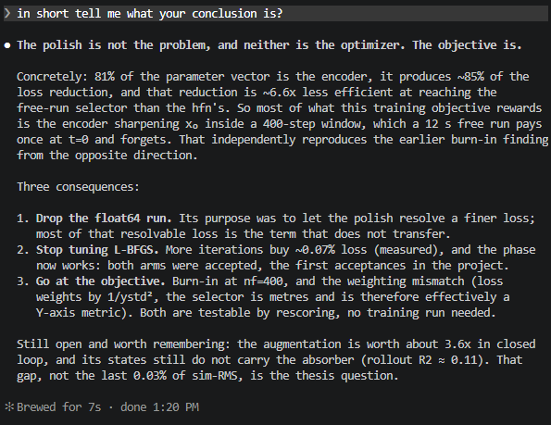
Encoder is the issue?
Objective dominated by startup transient
This: at nf=400 the objective is dominated by the startup transient, so the cheapest loss reduction available to any optimizer is refining x₀ — and the encoder is the thing that sets x₀, and it holds 81% of the parameters. That is why the effort lands there. The signature is in every run: grow between 0.46 and 0.81, meaning the error at the last step of a window is smaller than at the first.

Slide 46
Transient issue or decoupled?
The one finding I do think is worth showing is not about the optimiser at all: L-BFGS cut the training loss by 5.54% and moved the closed-loop validation by 0.032%. A 5.5% improvement in the quantity being minimised buys 0.03% of the quantity being selected on. That is direct evidence the objective and the selector are weakly coupled — the same conclusion figure 4 reaches from the transient, by a completely independent route. That is a real result and it strengthens next week's "the work is the objective" argument.

Slide 47
Orthogonality implementation

Slide 48
The problem is that the constraint is not enforced everywhere. It is enforced on a chosen finite set of evaluation points, and in our implementation that set pins x̄ = 0. So f_aug is constrained on one slice and free off it.

Slide 49
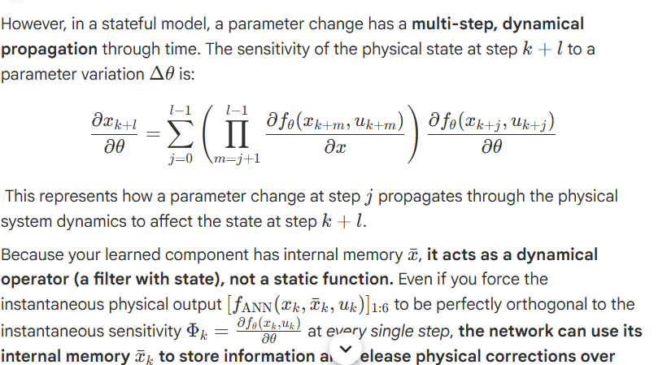

Slide 50
The theoretical gap you identified is the mathematical discrepancy between pointwise (instantaneous) orthogonality and trajectory-level (propagated) orthogonality over a multi-step rollout window

Slide 51
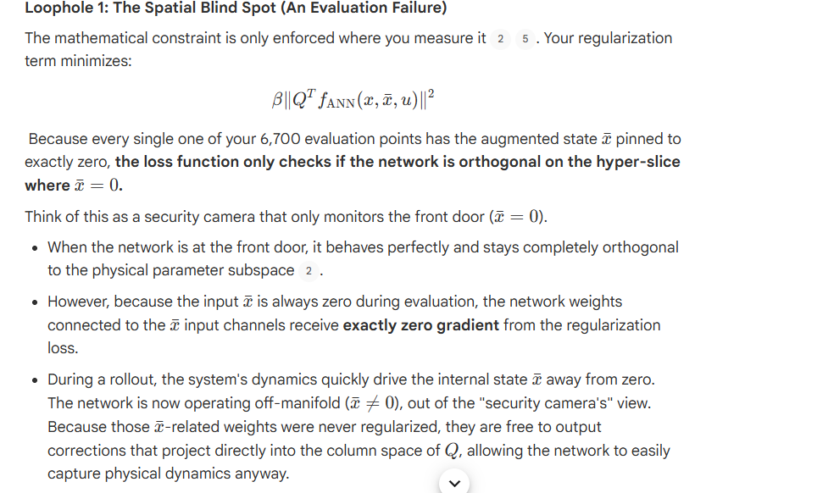
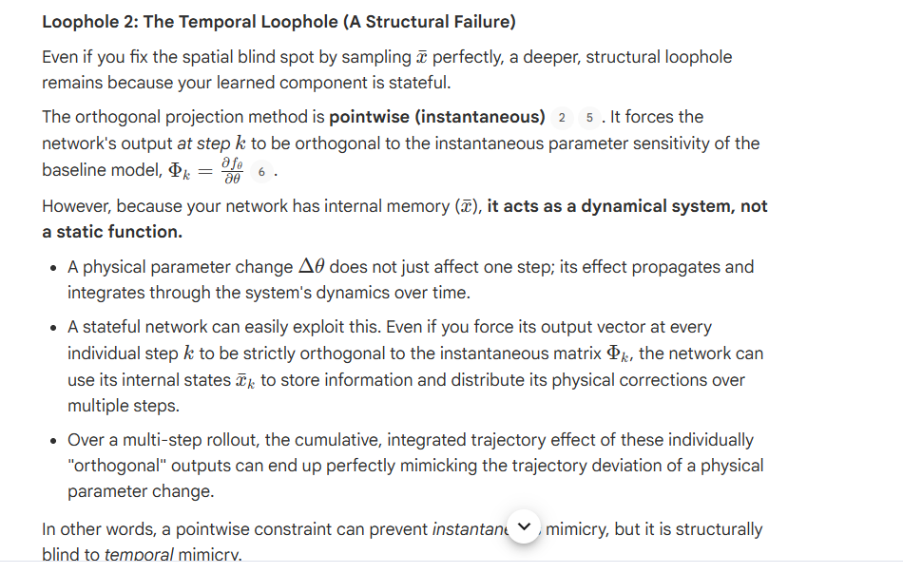
Loopholes with our implementation
The reason you are seeing a 4% "leakage" into that forbidden subspace is not because your understanding of the theory is wrong, but because your stateful setup has introduced two distinct loopholes that allow the network to bypass this constraint during rollouts.

Slide 52
Kijken voor wanneer presentatie → Quinten

Slide 53
What blocks getting a number at allFour items, all engineering, all with known fixes, none needing literature.θ has to actually move. This was the campaign's headline problem, and Phase 1 diagnosed it: Adam's eps, not the learning rate, was attenuating the stiffness and damping parameters, with a 7520x spread across parameters. lr_theta and eps_theta = 1e-16 are implemented and verified to fix the attenuation. But no full run has been done since. So the fix is proven on a probe and unproven on a training run.β has to actually act. In-loss under Adam it saturates into a β-independent plateau. Either implement the proximal form or accept that the coefficient is doing nothing above the plateau and say so.β has to transfer. The penalty is undivided per batch, so its value moves with stride, routing and batch count. The fix is a per-point normalisation and it is a few lines.The velocity channel. Forward difference where central is 12x better on dΘ, which is the channel the damping columns depend on. One line.Do those four and you can run the arms and get a parameter-recovery number.

Slide 54
The added states are the contribution. The mechanism is that the penalty checks the network on a slice the network can leave. Whether that is a live leak or a theoretical one is unmeasured, and one run measures it. The trajectory-propagation issue is a separate problem that applies to Gyorok too and should not lead.

Slide 55
Objective: does another field already have a construction that constrains an added learned term's cumulative effect over a window, rather than sample by sample?
Extend orthogonal-projection regularisation so it still protects physical-parameter interpretability when the augmentation has its own states — which Györök's does not, and which is why his pointwise penalty leaves 90% of our correction unconstrained.

Slide 56
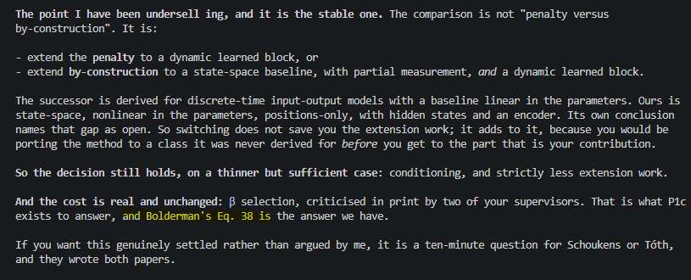
Beta decision
Bolderman answers how to set the drift-preventing weight without using test error, which is exactly what P1c needs.
Paper maarten critique op beta

Slide 57
Proof with sympy
could we use sympy to proof that a derivation works for the additional state?Yes, and there is a specific setup that makes it exact rather than approximate.Make the network affine and the window short. Take a one-layer affine φ, a window of T = 2 or 3, and symbolic θ. Then the whole rollout is closed-form: x̄_{k+1} = g_aug is affine in the previous state, the composition over the window is a finite product, and every quantity is a rational function of finitely many symbols. Sympy decides that class exactly.For the negative, this proves it outright. Construct explicit f_aug, g_aug that satisfy the pointwise condition at every evaluated point, then compute the cumulative contribution to the physical rows over the window and show it has a nonzero component in span(Ψ_T). That is an existence claim, so one witness settles it, and an affine witness is the strongest possible form: if even the simplest network can do it, a general one certainly can. Sympy verifies both halves, and the same instance runs numerically as a cross-check.For the positive, it gives base cases rather than a theorem. You can prove the extended condition bounds the cumulative contribution at T = 2, 3, 4 symbolically, see the pattern, and then the induction to general T is a short human argument that sympy checks the step of but cannot state. That is a normal division of labour, and it is honest to write it that way.What it still cannot reach: any statement quantified over all networks or all trajectories. Cho's ceiling is unaffected.This is well-defined enough to start. The first piece would be the affine counterexample at T = 2, which is a day at most and would give you the mathematical core of the contribution in a form a machine certifies.

Slide 58
How useful are Gramians?
Hankel singular values of the learned augmented subsystem
We can use gramians to determine “how much signal” is in a state.
your x̄ block is nonlinear and LPV

Slide 59
If I don’t get to real data nothing really showing nonlinear capabilities
Adding cubic spring instead?
Adding friction? Friction is nonlinear? To the system only?

Slide 60
Updated planning
Ook mailen!

Slide 62
Additional “proofs”

Slide 63
then what area of mathematics should we focus on to extend to additional states and the fact we have "memory" in our states. and is it possible to PROOF this? to is an actual proof and not only for our use case?Yes, and there is a specific answer rather than a vague one.The areaInner products on systems, not on vectors. The reason memory breaks Györök is that his Qᵀf = 0 is a Euclidean inner product in R^{n_x}, which has no notion of a signal arriving later. The object that does is the H₂ inner product on transfer functions:⟨G₁, G₂⟩ = (1/2π) ∫ trace( G₁(e^{jω})* G₂(e^{jω}) ) dωThis is a genuine inner product on dynamic operators, so "orthogonal" is well defined for systems with memory. And the parameter sensitivity is itself a system: ∂G/∂θᵢ is a transfer function, the sensitivity system. So the extension of Györök reads:⟨ ∂G/∂θᵢ , G_aug ⟩ = 0 for all iMemoryless is the special case where this collapses back to his pointwise condition. That is the generalisation you want, stated in one line.The part that ties your loose ends together⟨G₁, G₂⟩ is computed by solving a Stein equation A₁ X A₂ᵀ − X + B₁B₂ᵀ = 0, whose solution is Σₖ A₁^k B₁B₂ᵀ (A₂ᵀ)^k. Compare that with what came out of the affine derivation:Λ_T(i) = Σⱼ A^{T-1-j} K G^{j-1-i}Same object, truncated at horizon T. So Λ_T is not an ad-hoc formula, it is a finite-horizon Stein/Gramian, and this is where your model-reduction course genuinely enters: cross-Gramians are the machinery that computes the inner product between two systems, not merely a weighting I suggested earlier.Can it be proved in generalYes, for LTI, and this is the theorem shape:▎ Let G_θ be a parameterised model and Δ an unmodelled dynamic term. The first-order bias in θ̂ from fitting G_θ to data generated by G_θ* + Δ is determined by ⟨∂G/∂θᵢ, Δ⟩, and vanishes for every i exactly when Δ ⊥ span{∂G/∂θᵢ} in H₂.That is a real theorem, provable, and it is not about your gantry: it holds for any parameterised LTI model with any dynamic augmentation. Your θ_err = (ΦᵀΦ)^{-1}ΦᵀΔ bias relation is its memoryless shadow, so the two are already consistent.Honest caveats, all of which must be stated in the theorem, not hidden: LTI, first-order in the perturbation, quadratic loss, open loop. Your system is LPV and closed loop, so deployment needs either frozen-parameter/local versions or the LPV H₂ machinery (which exists, via LMIs, and is where it gets hard). The general theorem is the contribution; the LPV instance is the application.One thing before building it: I do not know whether this is already published. H₂-orthogonality between a sensitivity system and a residual is close enough to classical identifiability and to model-structure-selection work that it may exist under another name. That check is a deep-research run, one query, and it should happen before any derivation, because if it exists you cite it and inherit the proof instead of redoing it.

Slide 64
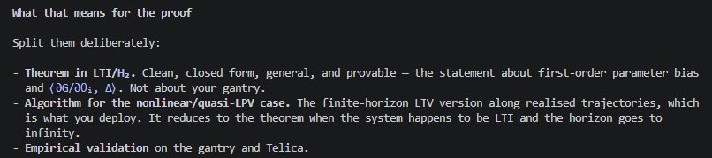
Algorithm for the nonlinear/quasi-LPV case. The finite-horizon LTV version along realised trajectories, which is what you deploy. It reduces to the theorem when the system happens to be LTI and the horizon goes to infinity.

